Slide 1
Introduction to Regression
Simple Linear Regression

Slide 2
Regression
Using regression analysis, we can derive an equation by which the dependent variable (Y) is expressed (and estimated) in terms of its relationship with the independent variable (X).
In simple regression, there is only one independent variable (X) and one dependent variable (Y). The dependent variable is the outcome we are trying to predict.
In multiple regression, there are several independent variables (X₁, X₂, …) and still only one dependent variable, Y. We are trying to use the X variables to predict the Y variable.
We will be studying Simple Linear Regression, in which we investigate whether X and Y have a linear relationship.

Slide 3
Simple Regression: An Example
A researcher wishes to determine the relationship between hours studied and grade on quiz. It is important to know which is the dependent variable, the one you are studying and, ultimately, trying to predict. Presumably, the number hours studied affects the grade on a quiz, not the other way around.
The data, for n=5 students:
Hours Studied (X) | Grade on Quiz (Y)
1 | 40
2 | 50
3 | 60
4 | 70
5 | 80

Slide 4
Simple Regression: An Example
If you plot the above pairs of data, you will find that all the points are on a straight line. This, of course, means that we have a perfect linear relationship between X and Y.
From studying correlation, you know that for this data r=+1 and R²=100%.
What happens when you add another point? For X=6 can you predict Y?
Note that this might or might not be accurate.

Slide 5
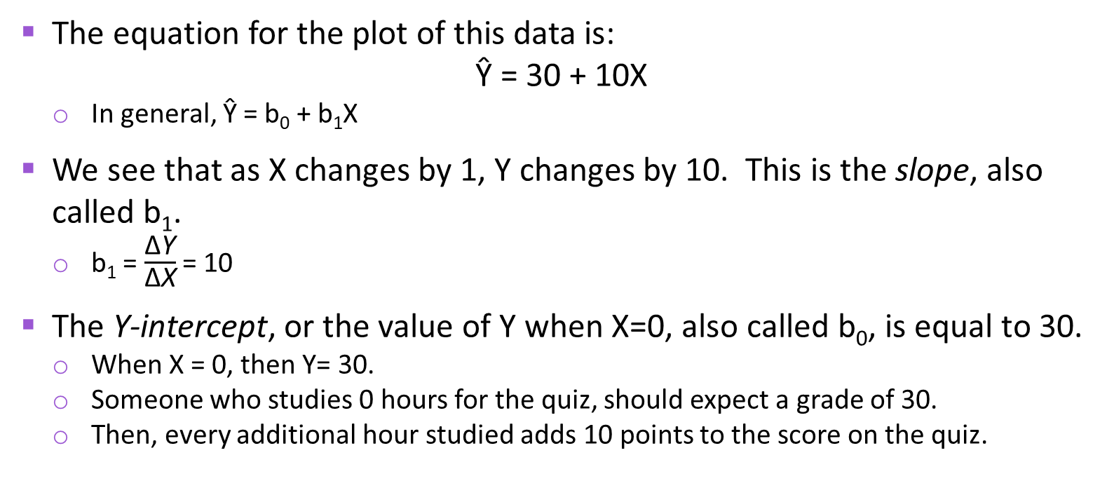
Simple Regression: An Example
Ŷ
Y
The equation for the plot of this data is:
Ŷ = 30 + 10X
In general, Ŷ = b₀ + b₁X
We see that as X changes by 1, Y changes by 10. This is the slope, also called b₁.
b₁ = $\frac{\text{∆}\text{Y}}{\text{∆}\text{X}}$= 10
The Y-intercept, or the value of Y when X=0, also called b₀, is equal to 30.
When X = 0, then Y= 30.
Someone who studies 0 hours for the quiz, should expect a grade of 30.
Then, every additional hour studied adds 10 points to the score on the quiz.
X

Slide 6
Simple Linear Regression
In general, the simple linear regression equation is:
Ŷ_{i} = b₀ + b₁X
Why do we need regression in addition to correlation?
To predict a Y for a new value of X.
To answer questions regarding the slope.
Finally, it makes the scatter plot a better display (graph) of the data if we can plot a line through it. It presents much more information on the diagram.
In correlation, on the other hand, we just want to know if two variables are related. This is used a lot in social science research.
If we raise prices by a particular amount or percentage, will it cause sales to drop? (This measures elasticity.)
EXAMPLES
With additional shelf space (X), what effect will there be on sales (Y)?

Slide 7
Simple Linear Regression
The regression equation Ŷ_{i} = b₀ + b₁X_{i} is a sample estimator of the true population regression equation, which we could build were we to take a census. This is
Y_{i} = β₀ + β₁X_{i} + ε_{i}
where,
β₀ = true Y intercept for the population
β₁ = true slope for the population
ε_{i} = random error in Y for observation i
In regression analysis, we hypothesize that there is a true regression line for the population. The b₀ and b₁ coefficients are estimates of the true population coefficients, β₀ and β₁.

Slide 8
Simple Linear Regression
In the example here, we see that most of the points are either above the line or below the line.
Mathematically, the regression line minimizes the sum of the squared errors (SSE), also called residuals:
Σe_{i}² = Σ(Y_{i} - Ŷ_{i})² = Σ[Y_{i} – (b₀ + b₁X_{i})]²
This is why the regression line is called the least squares line. It is the line that minimizes the sum of squared residuals (SSE). By taking partial derivatives, mathematicians derive the “normal equations” that are used to solve for b₀ and b₁.

Slide 9




Simple Linear Regression
NOTE: In regression, the levels of X are considered to be fixed. Y is the random variable.
Residuals, the deviations of the individual observations (the points) from the corresponding point on the regression line, are denoted by e_{i}: e_{i} = (Y_{i} - Ŷ_{i})
where:
Y_{i} is an individual data value (at X_{i})
Ŷ_{i} is a point on the regression line (at X_{i})
Some deviations are positive (for the points above the line); some are negative (for the points below the line). If a point is on the line, its deviation = 0.
Note that the Σe_{i} = 0.
$\overline{Y}$ is shown for reference

Slide 10
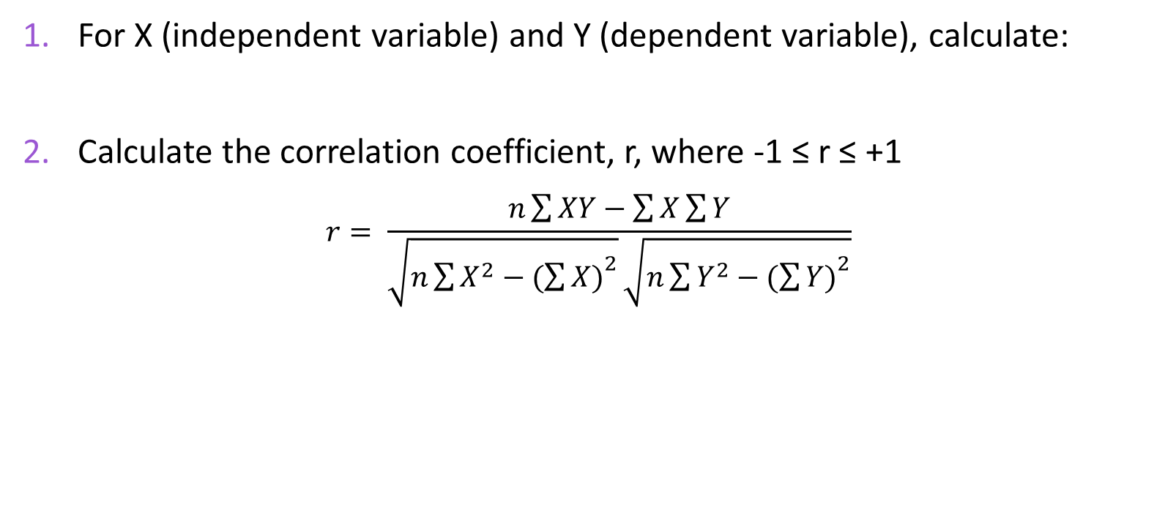
Steps in Regression
For X (independent variable) and Y (dependent variable), calculate:
Calculate the correlation coefficient, r, where -1 ≤ r ≤ +1
$$r= \frac{n\sum{XY−\sum{X\sum{Y}}}}{\sqrt{n\sum{X^{2}−{(\sum{X)}}^{2}}}\sqrt{n\sum{Y^{2}−{(\sum{Y)}}^{2}}}}$$
∑X_{i} | ∑Y_{i} | ∑ X_{i}Y_{i} | ∑X_{i}² | ∑Y_{i}²
Note: The correlation can be tested for significance, H₀: ρ=0. If the correlation is not significantly different from zero, X and Y are not related, and you really should not be doing the regression.

Slide 11
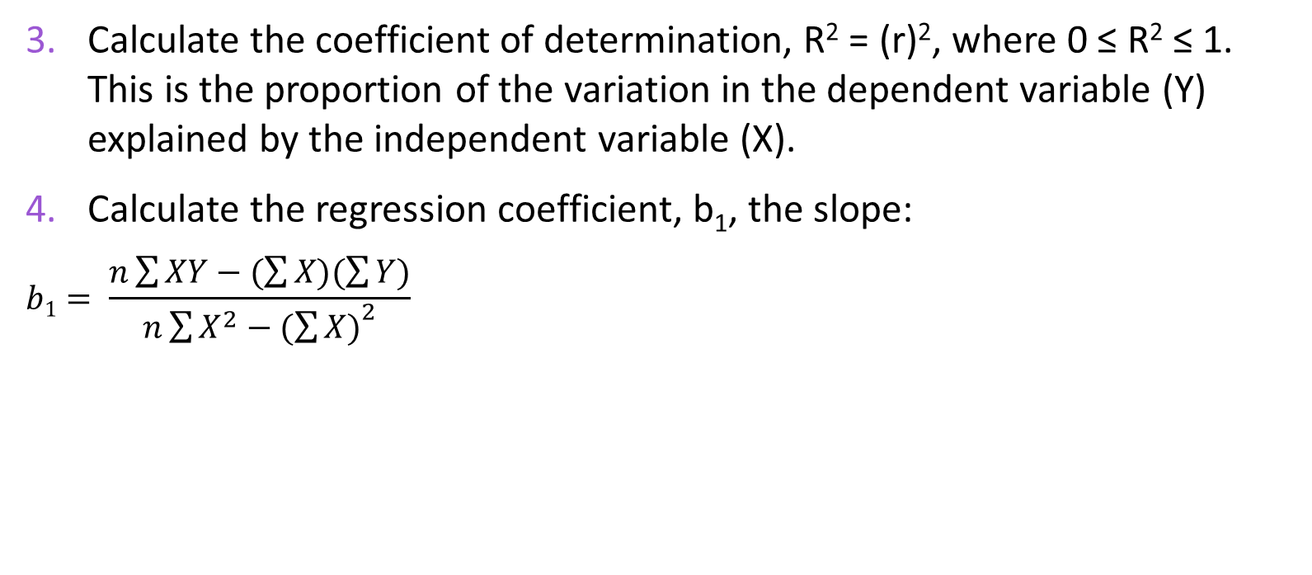
Steps in Regression
Calculate the coefficient of determination, R² = (r)², where 0 ≤ R² ≤ 1. This is the proportion of the variation in the dependent variable (Y) explained by the independent variable (X).
Calculate the regression coefficient, b₁, the slope:
$$b1= \frac{n\sum{XY−(\sum{X)(\sum{Y)}}}}{n\sum{X^{2}−{(\sum{X)}}^{2}}}$$
Note that you have already calculated the numerator and the denominator as part of r. Other than a single division operation, no new calculations are required here.
Are r and b₁ related? Yes! If a correlation is negative, the slope term must be negative; a positive slope means a positive correlation.

Slide 12

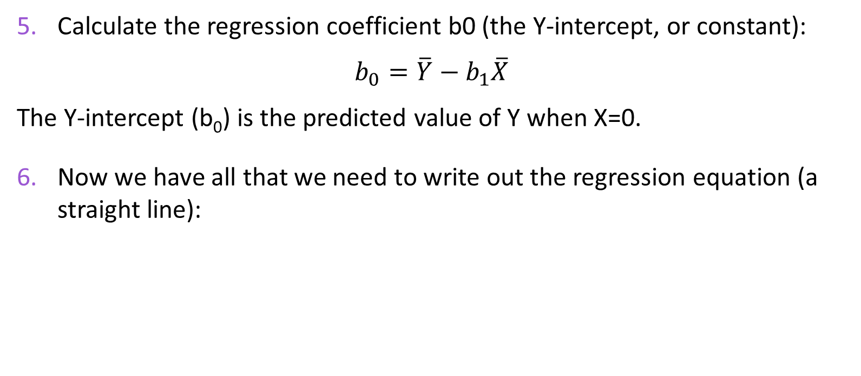
Steps in Regression
Calculate the regression coefficient b0 (the Y-intercept, or constant):
$$b_{0}=\overline{Y}−b_{1}\overline{X}$$
The Y-intercept (b₀) is the predicted value of Y when X=0.
Now we have all that we need to write out the regression equation (a straight line):
$${\hat{Y}}_{i}=b_{0}+b_{1}X_{i}$$

Slide 13
Steps in Regression
[OPTIONAL] Test the regression for statistical significance. This is part of the output you see when you do regression in MS Excel.
Three ways to test for significance:

Slide 14
Example 1: Water and Tomato Yield
n = 5 pairs of X,Y observations
Independent variable (X) is amount of water (in gallons) used on crop
Dependent variable (Y) is yield (bushels of tomatoes).
Y_{i} | X_{i} | X_{i}Y_{i} | X_{i}² | Y_{i}²
2 | 1 | 2 | 1 | 4
5 | 2 | 10 | 4 | 25
8 | 3 | 24 | 9 | 64
10 | 4 | 40 | 16 | 100
15 | 5 | 75 | 25 | 225
40 | 15 | 151 | 55 | 418

Slide 15
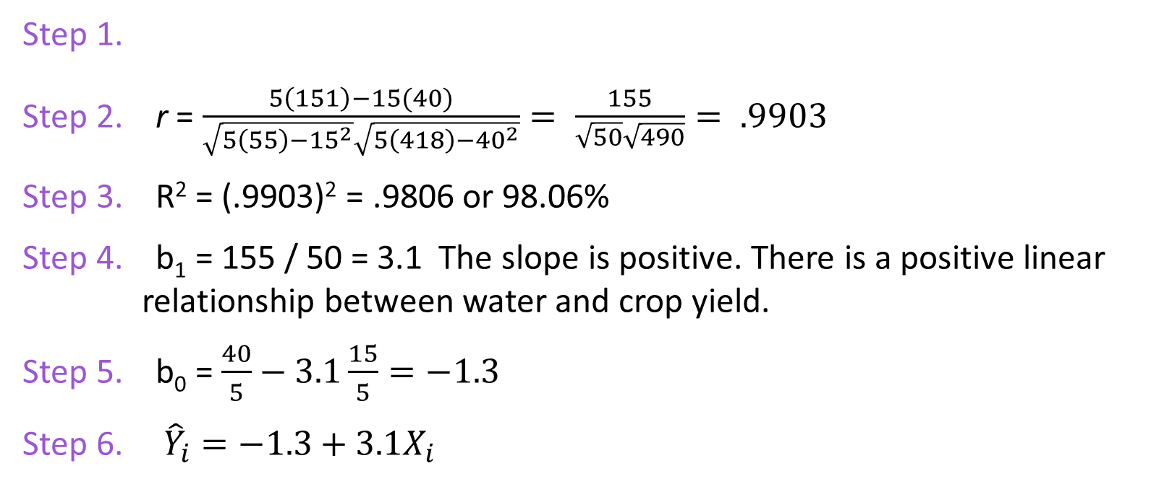
Example 1: Water and Tomato Yield
Step 1.
Step 2. r = $\frac{5\left(151\right)−15(40)}{\sqrt{5\left(55\right)−{15}^{2}}\sqrt{5\left(418\right)−{40}^{2}}}= \frac{155}{\sqrt{50}\sqrt{490}}= .9903$
Step 3. R² = (.9903)² = .9806 or 98.06%
Step 4. b₁ = 155 / 50 = 3.1 The slope is positive. There is a positive linear relationship between water and crop yield.
Step 5. b₀ = $\frac{40}{5}−3.1\frac{15}{5}=−1.3$
Step 6. ${\hat{Y}}_{i}=−1.3+3.1X_{i}$
∑X_{i} = 15 | ∑Y_{i} = 40 | ∑ X_{i}Y_{i}= 151 | ∑X_{i}²= 55 | ∑Y_{i}²= 418

Slide 16
Example 1: Water and Tomato Yield

Slide 17
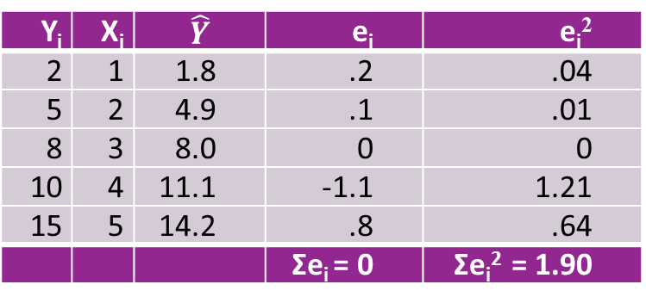
Example 1: Water and Tomato Yield
Y_{i} | X_{i} | $$\hat{Y}$$ | e_{i} | e_{i}²
2 | 1 | 1.8 | .2 | .04
5 | 2 | 4.9 | .1 | .01
8 | 3 | 8.0 | 0 | 0
10 | 4 | 11.1 | -1.1 | 1.21
15 | 5 | 14.2 | .8 | .64
 |  |  | Σe_{i} = 0 | Σe_{i}² = 1.90
Now we can answer a question like:
How many bushels of tomatoes can we expect if we use 3.5 gallons of water? Answer: -1.3 + 3.1 (3.5) = 9.55 bushels.
Notice there is a danger in predicting outside the range of X:
The more water, the greater the yield? No. Too much water can ruin the crop.
Σe_{i}² = 1.90
This is a minimum, since regression minimizes Σe_{i}² (SSE)

Slide 18
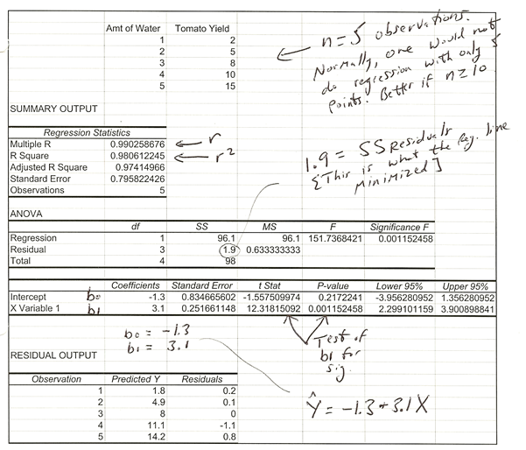
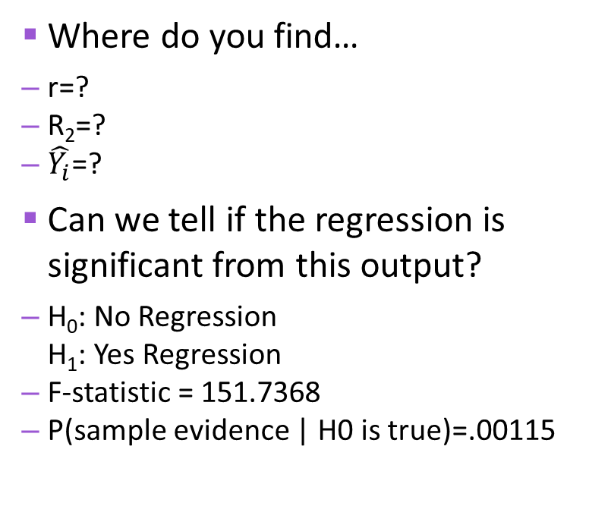
Same Example Using MS Excel
Where do you find…
r=?
R₂=?
$\hat{Y_{i}}$=?
Can we tell if the regression is significant from this output?
H₀: No Regression H₁: Yes Regression
F-statistic = 151.7368
P(sample evidence | H0 is true)=.00115
H₀: There is no linear relationship between X and Y

Slide 19






Sources of Variation in Regression
If we did not have a significant regression (i.e., X does not predict Y) we would use $\overline{Y}$instead as an estimator.
$$Y−\hat{Y}$$
$$Y−\overline{Y}$$
$$\hat{Y} − \overline{Y}$$

Slide 20
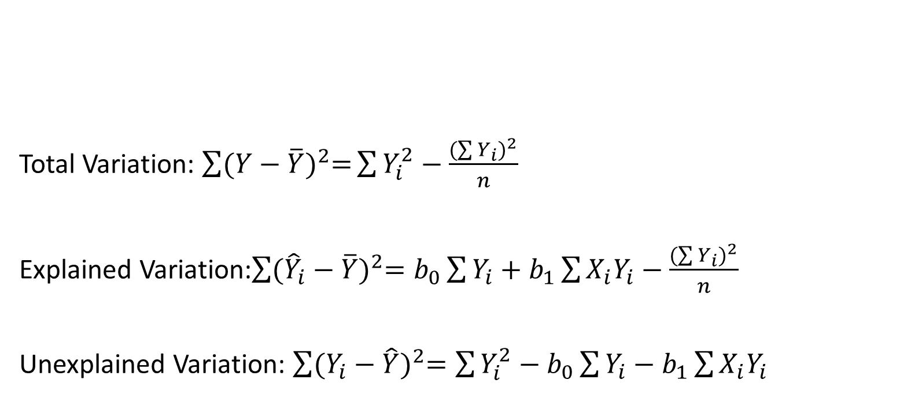
Sources of Variation in Regression
Total Variation: $\sum{{(Y−\overline{Y})}^{2}=}\sum{Y_{i}^{2}−\frac{{(\sum{Y_{i}})}^{2}}{n}}$
Explained Variation:$\sum{{({\hat{Y}}_{i}−\overline{Y})}^{2}=b_{0}\sum{Y_{i}+b_{1}\sum{X_{i}Y_{i}−\frac{{(\sum{Y_{i}})}^{2}}{n}}}}$
Unexplained Variation: $\sum{{(Y_{i}−\hat{Y})}^{2}=\sum{Y_{i}^{2}−b_{0}\sum{Y_{i}−b_{1}\sum{X_{i}Y_{i}}}}}$

Slide 21
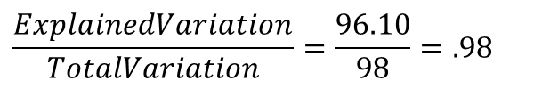
Sources of Variation in Regression
From our previous problem,
Total variation in Y = 418 – (40)²/5 = 98
Explained variation (explained by X) = -1.3(40) + 3.1(151) – (40)²/5 = 96.10
Unexplained variation = 418 - -1.3(40) - 3.1(151) = 1.90
Recall that the coefficient of determination, R², is the proportion of Y explained by X.
R² =
In other words, 98% of the total variation in crop yield is explained by the linear relationship of yield with amount of water used on the crop.
IT’S THE SAME!!
Before, we got: R² = r² = (.9903)² = .9806
$$\frac{ExplainedVariation}{TotalVariation}=\frac{96.10}{98}=.98$$

Slide 22
Example 2: Hours Studied & Grades
Let’s examine the relationship between hours studied and grade on a quiz. n=7 pairs of data. Highest grade on quiz is a 15.
We’ll call hours studied, X, and grade on quiz, Y.
WHY?
X_{i} | Y_{i} | X_{i}Y_{i} | X_{i}² | Y_{i}²
1 | 5 | 5 | 1 | 25
2 | 8 | 16 | 4 | 64
3 | 9 | 27 | 9 | 81
4 | 10 | 40 | 16 | 100
5 | 11 | 55 | 25 | 121
6 | 12 | 72 | 36 | 144
7 | 14 | 98 | 49 | 196
ΣX= 28 | ΣY= 69 | ΣXY= 313 | ΣX²= 140 | ΣY²= 731

Slide 23
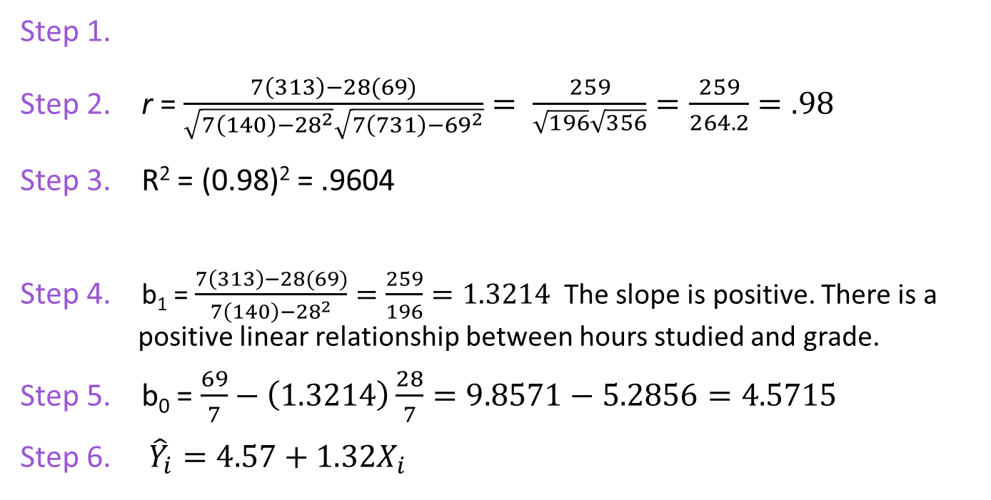
Example 2: Hours Studied & Grades
Get the needed sums
∑X_{i} = 28 | ∑Y_{i} = 69 | ∑ X_{i}Y_{i}= 313 | ∑X_{i}²= 140 | ∑Y_{i}²= 731
Step 1.
Step 2. r = $\frac{7\left(313\right)−28(69)}{\sqrt{7\left(140\right)−{28}^{2}}\sqrt{7\left(731\right)−{69}^{2}}}= \frac{259}{\sqrt{196}\sqrt{356}}=\frac{259}{264.2}=.98$
Step 3. R² = (0.98)² = .9604
Step 4. b₁ = $\frac{7\left(313\right)−28(69)}{7\left(140\right)−{28}^{2}}=\frac{259}{196}=1.3214$ The slope is positive. There is a positive linear relationship between hours studied and grade.
Step 5. b₀ = $\frac{69}{7}−\left(1.3214\right)\frac{28}{7}=9.8571−5.2856=4.5715$
Step 6. ${\hat{Y}}_{i}=4.57+1.32X_{i}$
Compute the correlation coefficient
The slope will also be positive.
Compute the coefficient of determination
Compute the regression coefficients, b₁ and b₀:
Compute the slope, b₁
Compute Y-intercept, b₀
Write out the regression equation

Slide 24
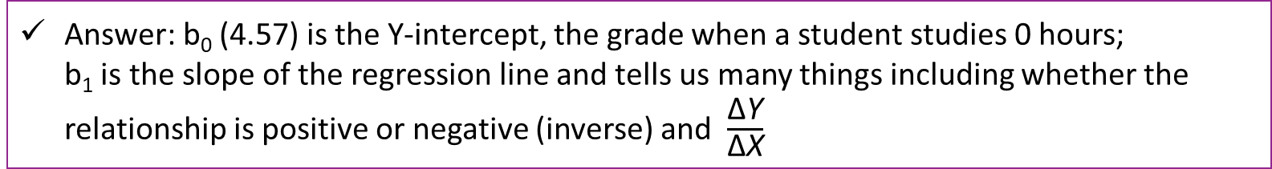

Example 2: Hours Studied & Grades
Try these yourself before advancing the slide.
For this regression equation: ${\hat{Y}}_{i}=4.57+1.3{2X}_{i}$
Q: Explain the meaning of the regression coefficients.
Q: If someone studies 3.5 hours, what would we predict his/her quiz score to be?
Answer: b₀ (4.57) is the Y-intercept, the grade when a student studies 0 hours; b₁ is the slope of the regression line and tells us many things including whether the relationship is positive or negative (inverse) and $\frac{\text{∆}\text{Y}}{\text{∆}\text{X}}$
Answer: 4.57 + 1.32 (3.5) = 9.2

Slide 25
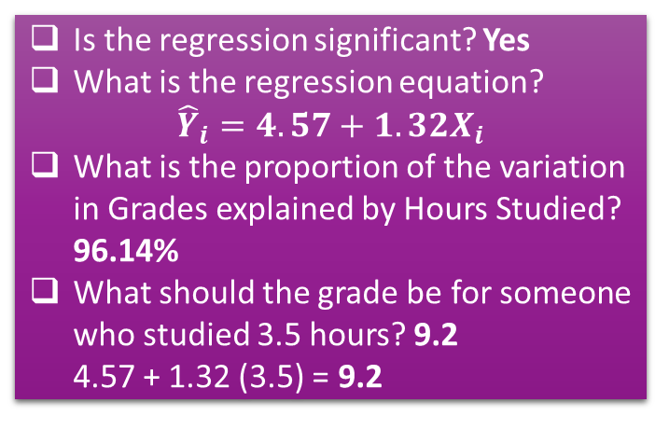
In Excel: Hours Studied & Grades
Is the regression significant? Yes
What is the regression equation? ${\hat{Y}}_{i}=4.57+1.3{2X}_{i}$
What is the proportion of the variation in Grades explained by Hours Studied? 96.14%
What should the grade be for someone who studied 3.5 hours? 9.2 4.57 + 1.32 (3.5) = 9.2

Slide 26
Example 3: Job Performance
X_{i} | Y_{i}
70 | 6
60 | 11
87 | 19
62 | 14
73 | 18
78 | 17
69 | 12
90 | 20
88 | 19
83 | 16
79 | 17
91 | 18
83 | 16
52 | 9
89 | 18
46 | 10
ΣX= 1200 | ΣY= 240
A company is interested in determining the relationship if any between the XYZ Major Field Test score for students graduating with a business degree and job performance score.
Job performance is measured by a team of supervisors and ranges from “awful” (0) to “outstanding” (20).
We’ll call Test Score, X, and Job Performance Score, Y.
WHY?

Slide 27
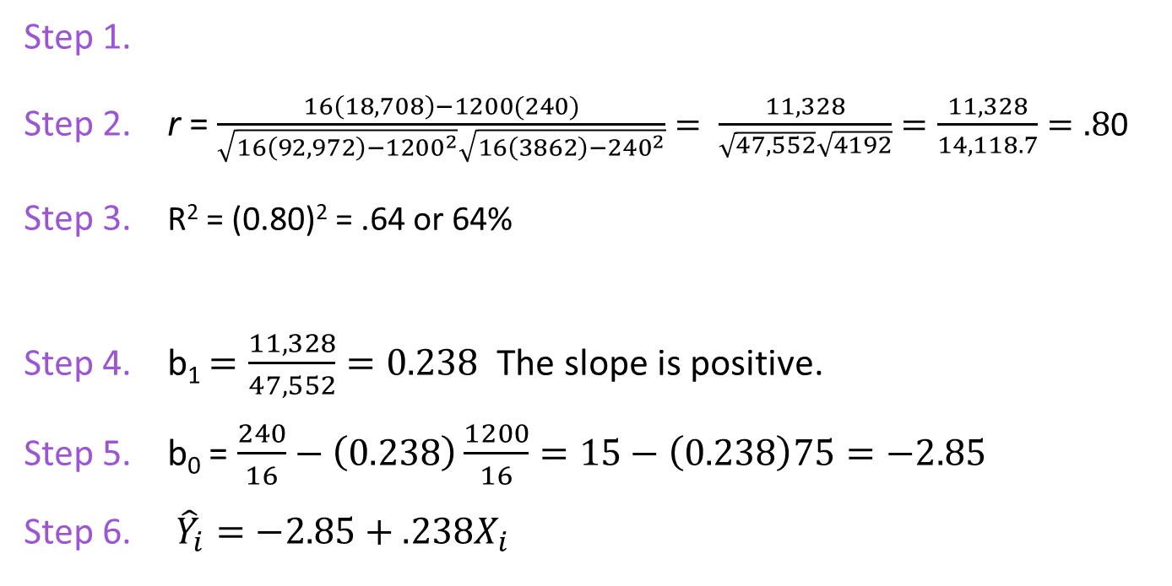
Example 3: Job Performance
Get the needed sums
∑X_{i} = 1200 | ∑Y_{i} = 240 | ∑ X_{i}Y_{i}= 18,708 | ∑X_{i}²= 92, 972 | ∑Y_{i}²= 3,862
Step 1.
Step 2. r = $\frac{16\left(18,708\right)−1200(240)}{\sqrt{16\left(92,972\right)−{1200}^{2}}\sqrt{16\left(3862\right)−{240}^{2}}}= \frac{11,328}{\sqrt{47,552}\sqrt{4192}}=\frac{11,328}{14,118.7}=.8$0
Step 3. R² = (0.80)² = .64 or 64%
Step 4. b₁ $=\frac{11,328}{47,552}=0.238$ The slope is positive.
Step 5. b₀ = $\frac{240}{16}−\left(0.238\right)\frac{1200}{16}=15−\left(0.238\right)75=−2.85$
Step 6. ${\hat{Y}}_{i}=−2.85+.238X_{i}$
Compute the correlation coefficient
The slope will also be positive.
Compute the coefficient of determination
Compute the regression coefficients, b₁ and b₀:
Compute the slope, b₁
Compute Y-intercept, b₀
Write out the regression equation

Slide 28
Example 3: Job Performance
LET’S SOLVE THIS WITH MS EXCEL
Regression Statistics
Multiple R | 0.802339566
R Square | 0.64374878
Adjusted R Square | 0.618302264
Standard Error | 2.582050952
Observations | 16
ANOVA
 | df | SS | MS | F | Significance F
Regression | 1 | 168.6621803 | 168.6622 | 25.29811103 | 0.000184094
Residual | 14 | 93.33781965 | 6.666987
Total | 15 | 262
 | Coefficients | Standard Error | t Stat | P-value | Lower 95% | Upper 95%
Intercept | -2.866756393 | 3.610409813 | -0.79403 | 0.440432812 | -10.6103153 | 4.876802511
X Variable 1 | 0.238223419 | 0.047363131 | 5.029723 | 0.000184094 | 0.136639605 | 0.339807232
r
R²
Regression is significant
b₀
b₁

Slide 29
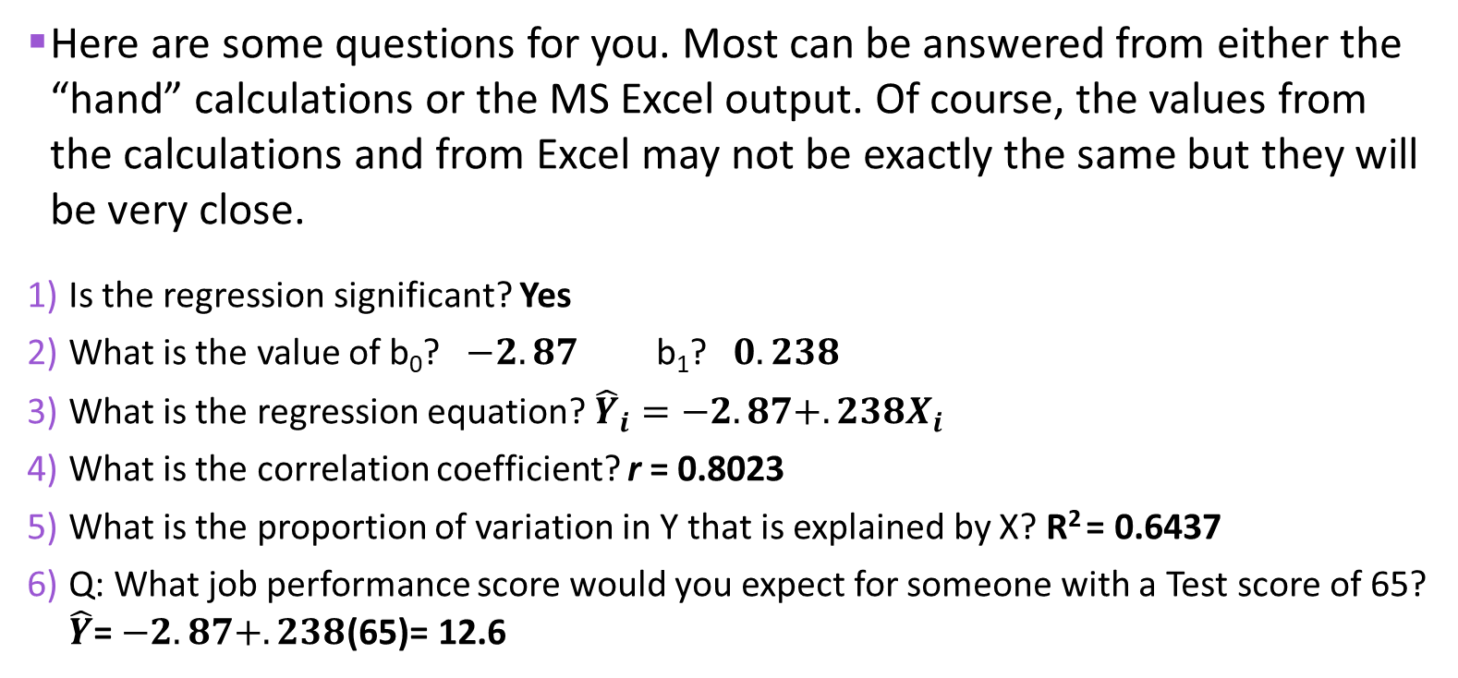
Example 3: Job Performance
Here are some questions for you. Most can be answered from either the “hand” calculations or the MS Excel output. Of course, the values from the calculations and from Excel may not be exactly the same but they will be very close.
Is the regression significant? Yes
What is the value of b₀? $−2.87$ b₁? $0.238$
What is the regression equation? ${\hat{Y}}_{i}=−2.87+.238X_{i}$
What is the correlation coefficient? r = 0.8023
What is the proportion of variation in Y that is explained by X? R² = 0.6437
Q: What job performance score would you expect for someone with a Test score of 65? $\hat{Y}$= $−2.87+.238$(65)= 12.6

Slide 30
More About Excel Output
Terms: -- df is degrees of freedom -- SS is sum of squares -- MS is mean square (SS / df)
ANOVA
 | df | SS | MS | F | Significance F
Regression | 1 | SSR | MSR | MSR/MSE
Residual (Error) | n-2 | SSE | MSE
Total | n-1 | SST
In simple regression, the degrees of freedom of the SS Regression is 1 (the number of independent variables). The degrees of freedom for the SSE (SS Residual) is n–2.
SSE is the sum of the squared residuals.
Note that some textbooks use the term Residuals and others use Error. They are the same thing and deal with the unexplained variation, i.e., the deviations. This is the number that is minimized by the least squares (regression) line.
Sum of Squares Total (SST) | = | Sum of Squares Regression (SSR) | + | Sum of Squares Error (SSE)
Total variation in Y | = | Explained Variation (Explained by the X-variable) | + | Unexplained Variation
SSR/SST is the proportion of the variation in the Y-variable explained by the X-variable. This is R-Square, the coefficient of determination.

Slide 31
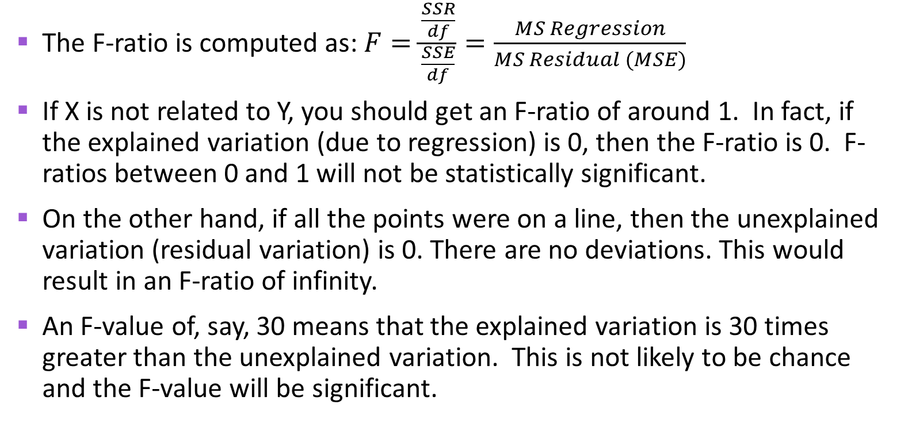
More About Excel Output
The F-ratio is computed as: $F=\frac{\frac{SSR}{df}}{\frac{SSE}{df}}=\frac{MS Regression}{MS Residual (MSE)}$
If X is not related to Y, you should get an F-ratio of around 1. In fact, if the explained variation (due to regression) is 0, then the F-ratio is 0. F-ratios between 0 and 1 will not be statistically significant.
On the other hand, if all the points were on a line, then the unexplained variation (residual variation) is 0. There are no deviations. This would result in an F-ratio of infinity.
An F-value of, say, 30 means that the explained variation is 30 times greater than the unexplained variation. This is not likely to be chance and the F-value will be significant.

Slide 32
Example 4: Education & Income (Using MS Excel)
A researcher is interested in determining whether there is a relationship between years of education and income.
Education X (years) | Income Y (in 000s)
9 | 20
10 | 22
11 | 24
11 | 23
12 | 30
14 | 35
14 | 30
16 | 29
17 | 50
19 | 45
20 | 43
20 | 70
SUMMARY OUTPUT
Regression Statistics
Multiple R | 0.860811139
R Square | 0.740995817
Adjusted R Square | 0.715095399
Standard Error | 7.816452413
Observations | 12
ANOVA
 | df | SS | MS | F | Significance F
Regression | 1 | 1747.947383 | 1747.947383 | 28.60941509 | 0.000324168
Residual | 10 | 610.9692833 | 61.09692833
Total | 11 | 2358.916667
 | Coefficients | Standard Error | t Stat | P-value | Lower 95% | Upper 95%
Intercept | -11.02047782 | 8.909954058 | -1.236872575 | 0.244393811 | -30.87309606 | 8.832140427
X Variable 1 | 3.197952218 | 0.597884757 | 5.348776972 | 0.000324168 | 1.865781732 | 4.530122704

Slide 33
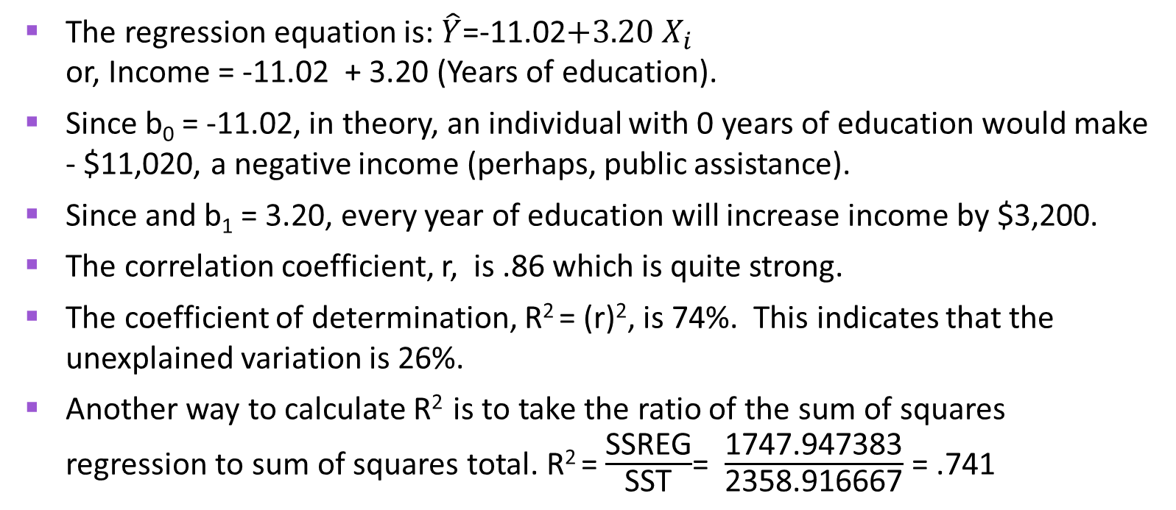
Example 4: Education & Income (Using MS Excel)
The regression equation is: $\hat{Y}$=-11.02$+3.20$ $X_{i}$ or, Income = -11.02 + 3.20 (Years of education).
Since b₀ = -11.02, in theory, an individual with 0 years of education would make - $11,020, a negative income (perhaps, public assistance).
Since and b₁ = 3.20, every year of education will increase income by $3,200.
The correlation coefficient, r, is .86 which is quite strong.
The coefficient of determination, R² = (r)², is 74%. This indicates that the unexplained variation is 26%.
Another way to calculate R² is to take the ratio of the sum of squares regression to sum of squares total. R² = $\frac{\text{SSREG}}{\text{SST}}$= $\frac{\text{1747.947383}}{\text{2358.916667}}$ = .741

Slide 34
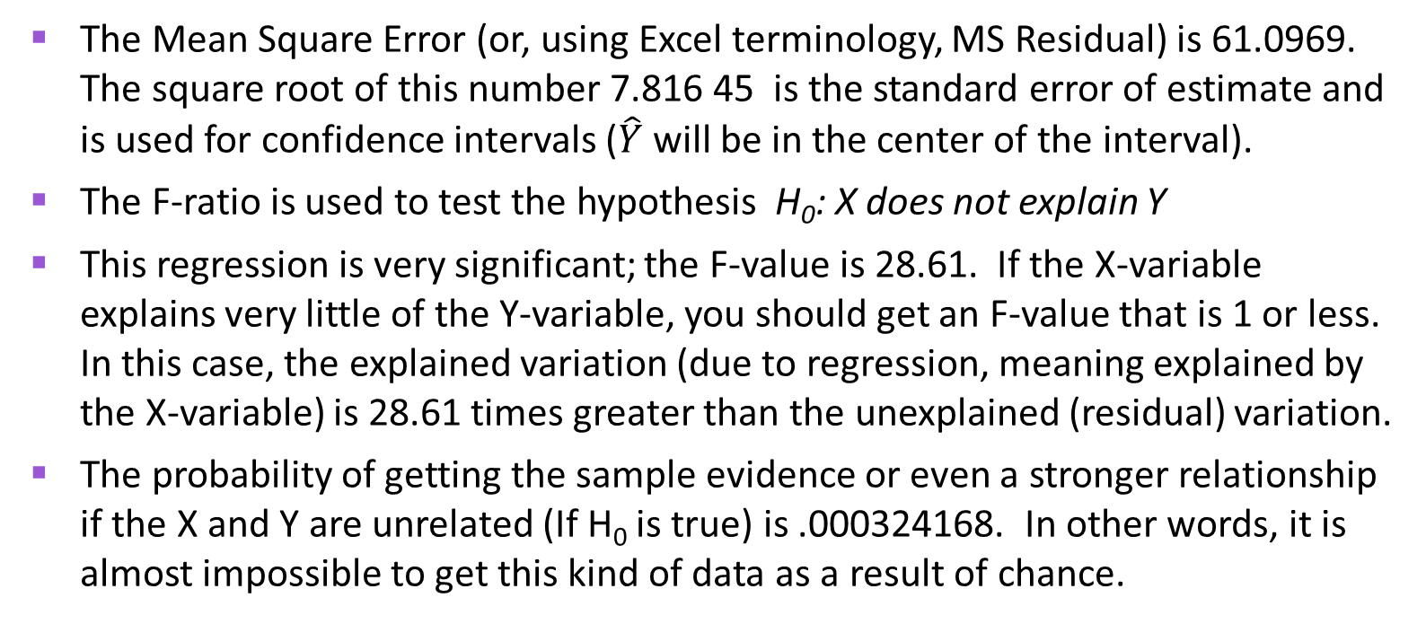
Example 4: Education & Income (Using MS Excel)
The Mean Square Error (or, using Excel terminology, MS Residual) is 61.0969. The square root of this number 7.816 45 is the standard error of estimate and is used for confidence intervals ($\hat{Y}$ will be in the center of the interval).
The F-ratio is used to test the hypothesis H₀: X does not explain Y
This regression is very significant; the F-value is 28.61. If the X-variable explains very little of the Y-variable, you should get an F-value that is 1 or less. In this case, the explained variation (due to regression, meaning explained by the X-variable) is 28.61 times greater than the unexplained (residual) variation.
The probability of getting the sample evidence or even a stronger relationship if the X and Y are unrelated (If H₀ is true) is .000324168. In other words, it is almost impossible to get this kind of data as a result of chance.

Slide 35
Example 4: Education & Income (Using MS Excel)
Another way to test the regression for significance is to test the b₁ coefficient (the slope term, which shows the effect of X on Y).
This is done via a t-test with H₀: ẞ₁=0 (no slope, so X has no effect on Y).
The t-value is 5.348776972 and this is very, very significant. The probability of getting a b₁ of this magnitude if H₀ is true, or one indicating an even stronger relationship, is 0.000324168.
Note that this is exactly the same p value we as for the F-test. Indeed, the two tests give exactly the same results.
Testing the b₁ term in simple regression is equivalent to testing the entire regression. After all, there is only one X variable in simple regression. In multiple regression we can use statistical tests for the individual b_{i} coefficients and an F-test for the overall regression.

Slide 36
Example 4: Education & Income (Using MS Excel)
Question: Using this regression equation, how much income would you predict for an individual with 18 years of education?
Answer: Income = -11.02 + 3.20 (18) = 46.58 in thousands
So the predicted income for 18 years of education is $46,580.
Of course, like any estimate there is a margin of error which we would see if we constructed a confidence interval. This is beyond the scope of this course and we will not learn it.

